Slide 1
CSC 455: Database Processing for Large-Scale Analytics
Lecture 3
Alexander Rasin
College of CDM, DePaul University
October 1st, 2013

Slide 2
Tonight
Normalization
SQL DDL
Python
SQL Queries

Slide 3
Normalization
EMPLOYEE(ID, First, Last, Team, Dept, Salary)
  ID → First
  ID → Last
  Last → Team
  ID → Salary
  Team → Salary
Primary key
2NF, 3NF

Slide 4
Normalization
Initial relational schema (1NF):
  INVOICE(OrderID, OrderDate, CustomerID, Name, Address, ProductID, Description, Finish, Price, Quantity)
Given FDs:
  ProductID → Description, Finish, Price
  OrderID → OrderDate, CustomerID, Name, Address
  CustomerID → Name, Address

Slide 5
Normalization
2NF Requirements
  Eliminate partial dependencies
  PrimaryKey is (ProductID, OrderID)
Partial dependencies
  ProductID → Description, Finish, Price
  OrderID → OrderDate, CustomerID, Name, Address

Slide 6
Normalization
3NF Requirements
  Eliminate transitive dependencies
  PrimaryKey1 is (ProductID, OrderID)
  PrimaryKey2 is ProductID
  PrimaryKey3 is OrderID
Transitive dependencies
  CustomerID → Name, Address

Slide 7
The End Result
A collection of tables in 3NF
  Each table has a primary key
  Every non-key attribute in a table is determined by the entire primary key
  No non-key attribute in a table is determined by any attributes other than the entire primary key
Information can reconstructed using joins

Slide 8
SQL DDL/Constraints
Database integrity
  Attribute constraints (NOT NULL, etc.)
    UNIQUE
  Primary Key (Unique values inserted)
  Foreign Key (Insert refers to valid PK)
Can define other constraints
  Write a SQL query to check your condition

Slide 9
Example
(StudentID, Name, Age, Transfer, Standing)
In-table
  Name VARCHAR2(35) NOT NULL,
ALTER TABLE Student
  ADD CONSTRAINT CheckName
  CHECK (Name IS NOT NULL);
  Retroactively checked!
  Try ALTER TABLE STUDENT ADD CONSTRAINT BadConstraint Unique(Name);

Slide 10
Example
Enforce an age range
  ALTER TABLE Student
  ADD CONSTRAINT AgeRange
  CHECK (Age BETWEEN 10 and 99);
Enforce freshman age
  ALTER TABLE Student
  ADD CONSTRAINT FreshmenAge
  Check (Standing = 'Freshman' AND Age < 30);

Slide 11
ALTER Table: Add
Add column
  ALTER TABLE Student
  ADD Address VARCHAR2(15);
  ALTER TABLE Student
  ADD (
  Income NUMBER(5, 2),
  Taxes NUMBER(5)
  );

Slide 12
ALTER Table
Drop column
  ALTER TABLE Student
  DROP COLUMN Address;
Modify column
  ALTER TABLE Student
  MODIFY Taxes NUMBER(5, 2);
  ALTER TABLE Student
  RENAME Column Taxes TO Tax;

Slide 13
Python
Booleans
  is_python = True
  this_is_not_true = False or 0 or “” or None
  these_are_true = True and 1 and “any text”
Operators
  a = 10
  a+=1
  a-=1
  b = 10*(a+1) - 50

Slide 14
Python
Operators
  c = a+b
  d = c * 2
  e = c * 2.0
  f = c / 2
  g = c % 3
  h = c ** 2

Slide 15
Python
String manipulation
  animals = “Cats “ + “Dogs “
  animals += “Rabbits”
  fruit = ‘, ‘.join([‘Apple’, ‘Banana’, ‘Orange’])
  address = ‘%d %s, %s %s %d’ % (243, ‘S. Wabash’, ‘Chicago’, ‘IL’, 60604)

Slide 16
Python
Logical comparison
  a and b
  a or b
  not a
  (a or not (b and c) or d)
  1 == ‘1’ # False
  1 == 1 # True

Slide 17
Python
Arithmetic comparison
  a > b
  a <= c
  b < b
  a == b
  c == d
  a < a+5

Slide 18
Python
Conditionals
  grade = 82
  If (grade >= 90):
  if (grade==100):
  print ‘A+’
  else:
  print ‘A’
  else:
  print “Not A”

Slide 19
Python
For loop
  for x in range(100):
  print “X = “, x
  fruit = [‘Apple’, ‘Banana’, ‘Orange’]
  fruit = ‘Apple, Banana, Orange’.split(‘, ‘)
  for value in fruit:
  print value

Slide 20
Python
states = {‘IL’ : ‘Illinois’, ‘ME’: ‘Maine’,
‘RI’: ‘Rhode Island’}
for key, value in states.items():
  print ‘%s: %s’ % (key, value)
While loop:
  x = 0
  while x < 1000:
  print “ X = “, x
  x -= 5

Slide 21
Python
def multiply(x, y):
return x*y
def printUpper(phrase = “No input”):
print phrase.upper()

Slide 22
Oracle Data Types
NUMBER(x, y)
CHAR(n)
VARCHAR(n) or VARCHAR2(m)
DATE
CLOB
BLOB

Slide 23
INSERT
Strings in (single) quotes
DATE
  9/Sept/September for month (not 09)
  Locale dependent conversion
  INSERT INTO Enrollment VALUES('45678', 'CSC451', to_date('05/2013/7', 'mm/yyyy/dd'));

Slide 24
UPDATE
UPDATE TABLE_NAME
SET Attribute = value
WHERE condition;
Sets Attribute to value in exactly those tuples that satisfy condition

Slide 25
UPDATE
UPDATE Store SET city= ’Bohston’ WHERE city = ‘Boston’;
  Updates Boston tuples to new spelling
UPDATE Store SET city= 'Boston' WHERE city LIKE 'B%ton';
  Set “Boston” spelling
  Includes “Boston”, “Bohston” and even “Brighton”

Slide 26
UPDATE
UPDATE Savings
SET Amount = Amount * 1.2
WHERE accountType = ‘CD’;
UPDATE Checking
SET Amount = Amount * 1.04
WHERE Amount > 50;

Slide 27
DELETE
DELETE FROM TABLE_NAME
WHERE condition;
Removes from the table exactly those tuples that satisfy condition

Slide 28
DELETE
DELETE FROM Store
WHERE City = ‘Boston’;
DELETE FROM Store
WHERE StoreID = 600;
DELETE FROM Transaction
WHERE TransID = 1;

Slide 29

A Break!

Slide 30
Python SQLite
import sqlite3
conn = sqlite3.connect('csc455.db')
c = conn.cursor()
c.execute( SQL Command )
conn.commit()
conn.close()

Slide 31
Python SQLite
ST = '''CREATE TABLE Student
(
ID VARCHAR2(5),
Name VARCHAR2(25),
Standing VARCHAR2(8),
CONSTRAINT Student_PK
PRIMARY KEY(ID)
); '''

Slide 32
Python SQLite
c.execute(ST)
c.execute("INSERT INTO Student VALUES ('12345', 'Paul K', 'Grad');");

Slide 33
Python SQLite
CT = """CREATE TABLE Course
(
CourseID VARCHAR2(15),
Name VARCHAR2(50),
Credits INTEGER,
CONSTRAINT Course_PK
PRIMARY KEY( CourseID)
); """

Slide 34
Python SQLite
c.execute(CT)
c.execute("INSERT INTO Course VALUES ('CSC451', 'Database Design', 4);");
Float → REAL datatype
Should use VARCHAR instead of VARCHAR2

Slide 35
Python SQLite
newData =[['23456', 'Larry P', 'Grad'],
['34567', 'Ana B', 'Ugrad'],
['45678', 'Mary Y', 'Grad'],
['56789', 'Pat B', 'Ugrad']]
c.execute("INSERT INTO Student VALUES (?, ?, ?);", newData[0]);
c.executemany("INSERT INTO Student VALUES (?, ?, ?);", newData[1:]);

Slide 36
Python SQLite
Why not do this? :
newRow = "INSERT INTO Student VALUES ('%s', '%s', '%s');" % (newData[0][0], newData[0][1], newData[0][2])
c.execute(newRow);

Slide 37
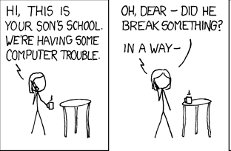
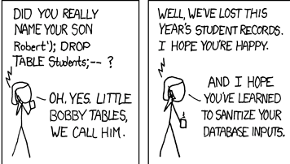

Slide 38
SQL Queries
General form of a query:
SELECT list of attributes to report
FROM list of tables
[WHERE tuple condition]
[GROUP BY list of grouping attributes]
[HAVING group condition]
[ORDER BY list of ordering attributes]
Result is an ordered set of tuples

Slide 39
SELECT FROM
SELECT list of attributes
FROM list of tables
SELECT gives which attributes to include
  give a single attribute, or a list
  * for all attributes
  DISTINCT will only report distinct tuples
FROM gives the source table(s)
  for now, just a single table

Slide 40
WHERE
WHERE condition
Each tuple is tested against the condition, and only those that satisfy it are returned by the query
Condition expression can contain:
  comparisons
  expressions with wildcards (for strings)
  boolean operations

Slide 41
Boolean Conditions
Truth/False
1/0
SELECT * FROM TABLE_NAME
WHERE condition;
  Need to decide if condition is a “true”

Slide 42
Comparisons
Put numerical or string value on each side, each comparison returns true or false
  = is equal to
  != or <> is not equal to
  > is greater than
  >= is greater than or equal to
  < is less than
  <= is less than or equal to

Slide 43
Wildcards
Using LIKE, we can compare character strings to strings that include wildcard characters that match anything:
  _ matches any single character
  % matches any consecutive set of characters
For example:
  ‘b_d’ will match ‘bad’, ‘bed’, but not ‘band’
  ‘bat%’ will match ‘bat’, ‘bath’, ‘battery’…

Slide 44
More Examples
SELECT * FROM Enrolled
WHERE Enrolled.cid LIKE ‘Pilates%’;
SELECT * FROM Student
WHERE Student.login LIKE ‘_smith%’;

Slide 45
Boolean Operations
For single conditions use the immediate result
Can combine multiple conditions with boolean operators
  AND
  OR
  NOT

Slide 46
AND Operator
Binary operator (2 inputs)
Condition1 AND Condition2
  True if both Condition1 and Condition2 are true
( ( Condition3 AND Condition4 ) AND Condition5 )
  Condition3_and_4 AND Condition5

Slide 47
OR Operator
Binary operator
Condition1 OR Condition2
  True if either Condition1 or Condition2 is true
( ( Condition3 OR Condition4 ) OR Condition5 )
  Condition3_or_4 OR Condition5

Slide 48
NOT Operator
Unary operator
  Applies to 1 thing only
NOT Condition1
  True if either Condition1 is false
NOT (NOT Condition2)
  Equivalent to Condition2
  True if Condition2 is true

Slide 49
Combining AND/OR/NOT
Condition1 AND Condition2 OR Condition3
Parenthesis are important
  (Condition1 OR Condition2) AND Condition3
  Condition1 OR (Condition2 AND Condition3)
Example
  Condition1 = Flight departing today
  Condition2 = Flight departing tomorrow
  Condition3 = Flight departing from Chicago

Slide 50
Combining AND/OR/NOT
Condition1 AND NOT Condition2
Condition1 AND (NOT Condition2)
Example
  Condition1 = Ticket costs less than $300
  Condition2 = Ticket sold by United

Slide 51
NULLs
The “dirty little secret” of SQL (major headache for query optimization), since it can be a value for any attribute.
What does this mean?
  We don’t know Compton assets?
  Compton has no assets?
bname | city | assets
Downtown | Boston | $9,000,000
Compton | Los Angeles | NULL
Long Beach | Los Angeles | $400,000
Harlem | New York | $1,700,000

Slide 52
NULLs
bname | city | assets
Downtown | Boston | $9,000,000
Compton | Los Angeles | NULL
Long Beach | Los Angeles | $400,000
Harlem | New York | $1,700,000
X
SELECT * FROM branch WHERE assets = NULL
bname | city | assets
SELECT * FROM branch WHERE assets IS NULL
bname | city | assets
Compton | Los Angeles | NULL

Slide 53
ORDER BY
ORDER BY list of ordering attributes
Tuples returned by the query are sorted by the first attribute in the list
Ties are broken by the second attribute, then the third, et cetera
Tuples are sorted in ascending order unless we put DESC after an attribute

Slide 54
Output Control
ORDER BY <column*> [ASC|DESC]
  Order the output tuples by the values in one or more of their columns.
sid | grade
53123 | A
53334 | A
53650 | B
53666 | D
SELECT sid, grade FROM Enrolled
WHERE cid = ‘Pilates105’
ORDER BY grade;
sid
53666
53650
53123
53334
grade
D
B
A
A
SELECT sid, grade FROM Enrolled
WHERE cid = ‘Pilates105’
ORDER BY grade DESC;

Slide 55
Aggregate Functions
Given an attribute, these functions will collect their results from the values of that attribute in the set of returned tuples:
  Compute the average company salary
  Find the average GPA for a course
  Find the highest amount transaction

Slide 56
Aggregates
Functions that return a single value from a group of tuples:
  AVG(col)→ Return the average value of column
  MIN(col)→ Return minimum column value
  MAX(col)→ Return maximum column value
  SUM(col)→ Return sum of values in column
  COUNT(col) → Return the # of values for col

Slide 57
Aggregates
Functions can only be used in attribute list:
Can use multiple functions at same time:
cnt
12
SELECT COUNT(login) AS cnt
FROM Student WHERE login LIKE ‘%@cdm’
AVG(gpa) | COUNT(sid)
3.25 | 12
SELECT AVG(gpa), COUNT(sid)
FROM Student WHERE login LIKE ‘%@cdm’

Slide 58
Aggregates
COUNT/SUM/AVG support DISTINCT:
The output of other columns outside of an aggregate is undefined:
COUNT(DISTINCT login)
10
SELECT COUNT(DISTINCT login)
FROM Student WHERE login LIKE ‘%@cdm’
AVG(s.gpa) | e.cid
3.5 | ???
SELECT AVG(s.gpa), e.cid
FROM Enrolled AS e, Student AS s
WHERE e.sid = s.sid;

Slide 59
GROUP BY
GROUP BY list of grouping attributes
We can combine the tuples returned by a query into sets based on the value of some attribute(s), and report the value(s) of this attribute(s) and aggregate information for each group
Once we group, we cannot look at the values in the individual tuples anymore…

Slide 60
Joins
Data that is distributed among different tables can be combined into a single set of tuples using different types of joins:
  Equi-join
  Natural join
  Inner join
  Outer join (left, right, full)

Slide 61
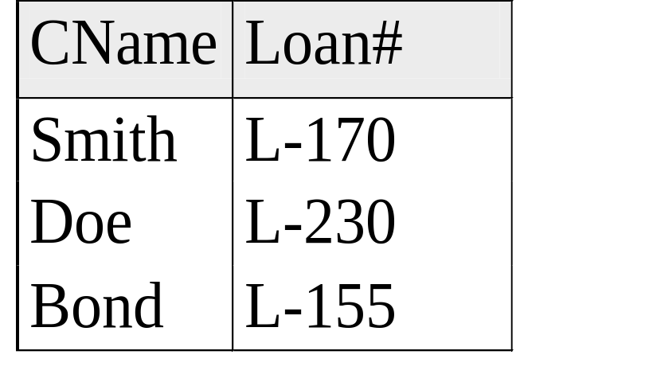
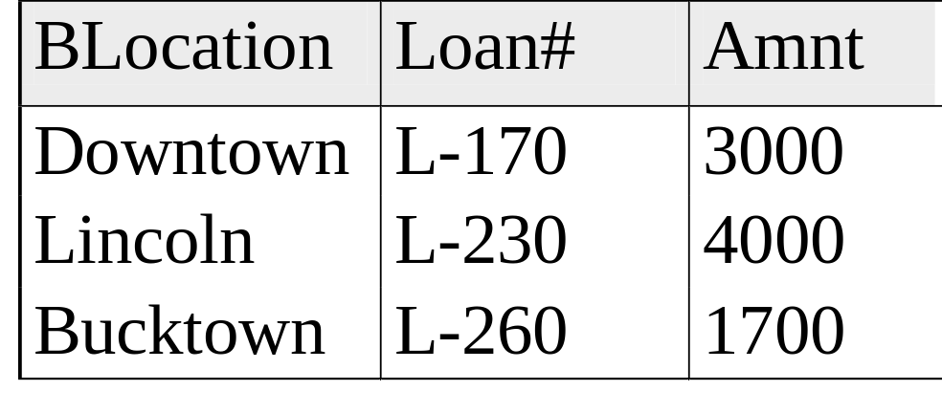
Customer and Bank Branch Data

Slide 62
Cartesian Product
What if we list two tables in FROM clause?
The tuples in the result come from combining all pairs of tuples from the two tables – Cartesian Product of the tables
This is probably more tuples than we want – most combinations are likely to be meaningless!

Slide 63
Cartesian Product
SELECT *
FROM customer, branch;
BLocation | Branch. Loan# | Amnt | Cname | Customer. Loan#
Downtown | L-170 | 3000 | Smith | L-170
Lincoln | L-230 | 4000 | Smith | L-170
Bucktown | L-260 | 1700 | Smith | L-170
Downtown | L-170 | 3000 | Doe | L-230
Lincoln | L-230 | 4000 | Doe | L-230
Bucktown | L-260 | 1700 | Doe | L-230
Downtown | L-170 | 3000 | Bond | L-155
Lincoln | L-230 | 4000 | Bond | L-155
Bucktown | L-260 | 1700 | Bond | L-155

Slide 64
Equi-Join
An equi-join keeps only those tuples where the two combined tuples agree on the shared attribute(s):
SELECT …
FROM TABLE1, TABLE2
WHERE
TABLE1.Attribute = TABLE2.Attribute;

Slide 65
Equi-Join
SELECT *
FROM branch, customer
WHERE customer.LoanNum = Branch.LoanNum;
BLocation | Customer. Loan# | Amnt | Cname | Branch. Loan#
Downtown | L-170 | 3000 | Smith | L-170
Lincoln | L-230 | 4000 | Doe | L-230

Slide 66
Natural Join
Like an equi-join, but one of the duplicated columns is removed (the most common type join):
SELECT (all but the duplicated attribute)
FROM TABLE1, TABLE2
WHERE
TABLE1.Attribute = TABLE2.Attribute;

Slide 67
Natural Join
SELECT BLocation, customer.LoanNum, Amnt, CName
FROM customer, branch
WHERE customer.LoanNum = Branch.LoanNum;
BLocation | Customer. Loan# | Amnt | CName
Downtown | L-170 | 3000 | Smith
Lincoln | L-230 | 4000 | Doe

Slide 68
Next Time:
More SQL Queries
  Outer joins
(Assignment 2 posted tonight)

